Slide 1
Investigation of Instacart Data
Mingjie Zhao, Duke University

Slide 2
Background
Problem description
5 datasets
Objective
Provide insights by digging into data
Methodology
Analyze the dataset using data science knowledge

Slide 3
Methodology
Sales analysis
Customer analysis
Orders analysis

Slide 4
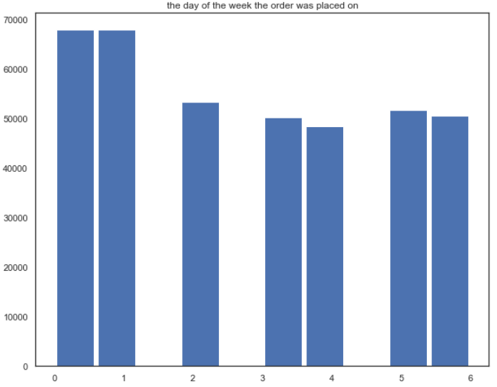
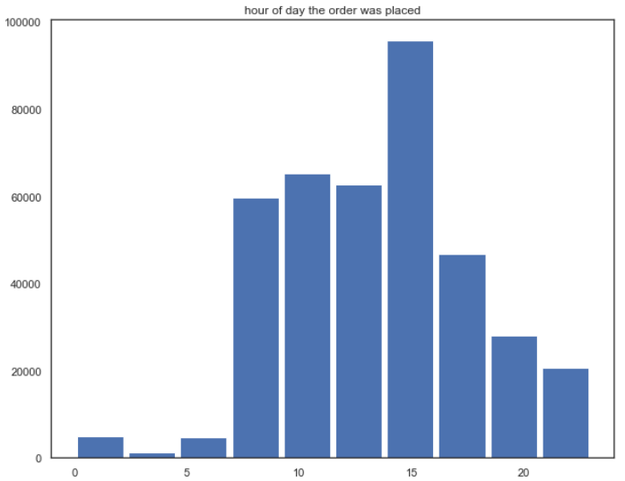
Sales analysis
When do people order?

Slide 5
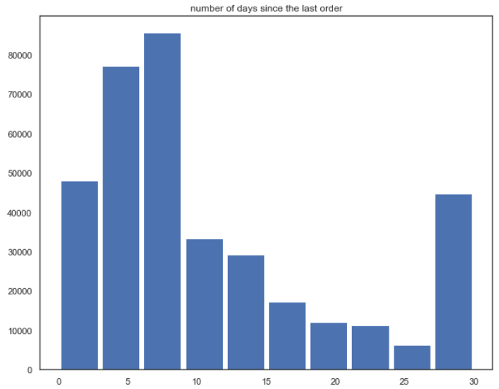
Sales analysis
When do people order AGAIN?

Slide 6
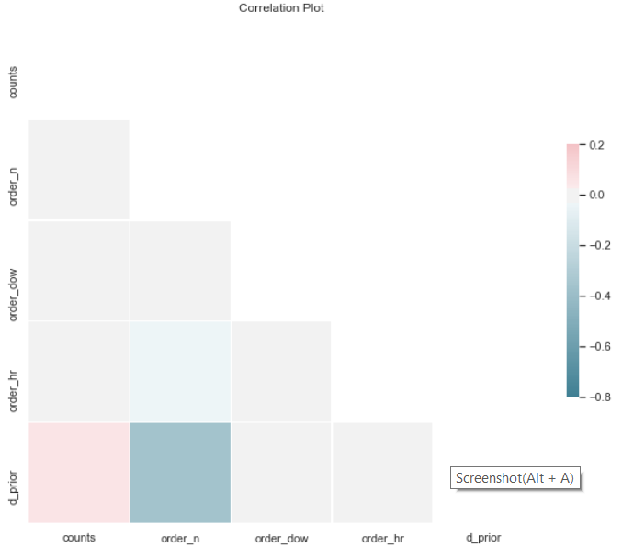
Sales analysis
Order sequence number is highly correlated with number of days since last order
Customers tend to shop more frequently when they made more orders

Slide 7
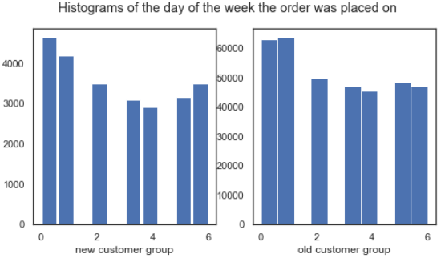
Customer analysis
New customer vs old customer

Slide 8
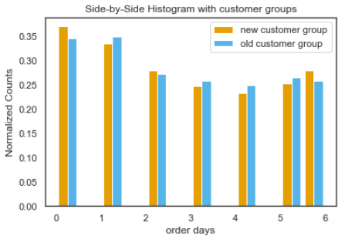
Customer analysis
New customer vs old customer

Slide 9
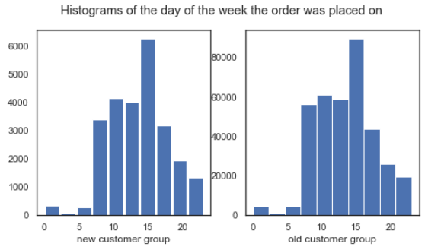
Customer analysis
New customer vs old customer

Slide 10
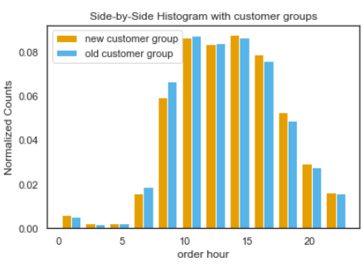
Customer analysis
New customer vs old customer

Slide 11
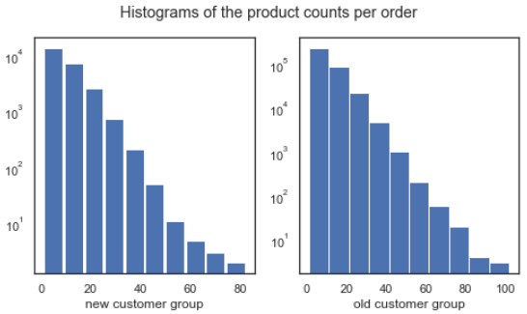
Customer analysis
New customer vs old customer

Slide 12
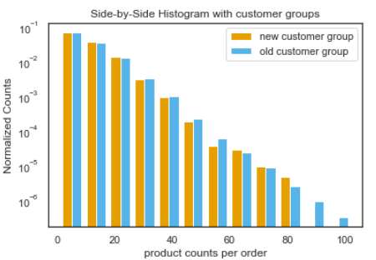
Customer analysis
New customer vs old customer

Slide 13
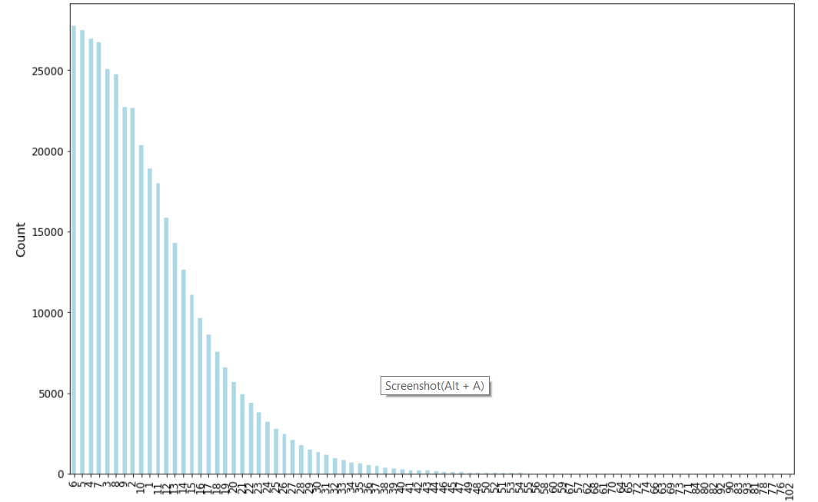
Orders analysis
check how many items in each order

Slide 14
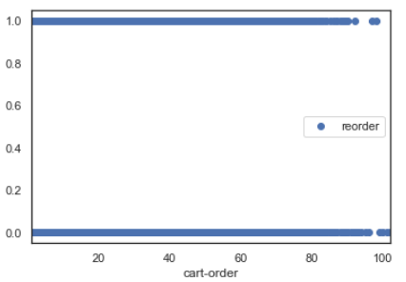
Orders analysis
No significant patterns between cart order and reorder

Slide 15
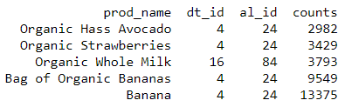
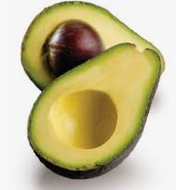
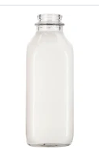
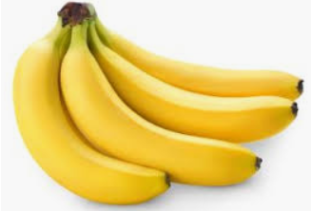
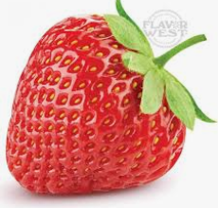
Orders analysis
what is the most common thing people get into the cart FIRST¶

Slide 16
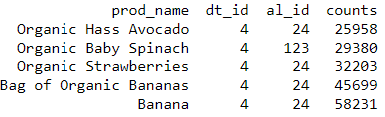
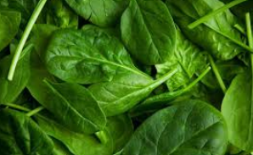
Orders analysis
what is the most common thing people get into the cart in general

Slide 17
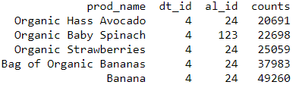
Orders analysis
what is the most common thing people reorder

Slide 18
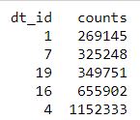
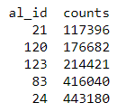
Orders analysis
What is the most popular department and aisle?
Department 4
Aisle 24

Slide 19
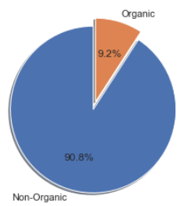
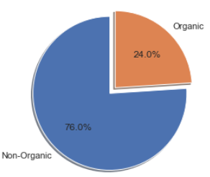
Orders analysis
Organic vs Non-organic products
Products
Orders

Slide 20
Conclusions
Best day and time for sale events
1st and 2nd day of the week, 3pm
Best day and time to attract new customers
1st day of the week, 10am-3pm
Most of the orders include more than 1 product
People who shop more, shop often
More bananas, strawberries, spinach and avocado
People love organic products!

